Slide 1
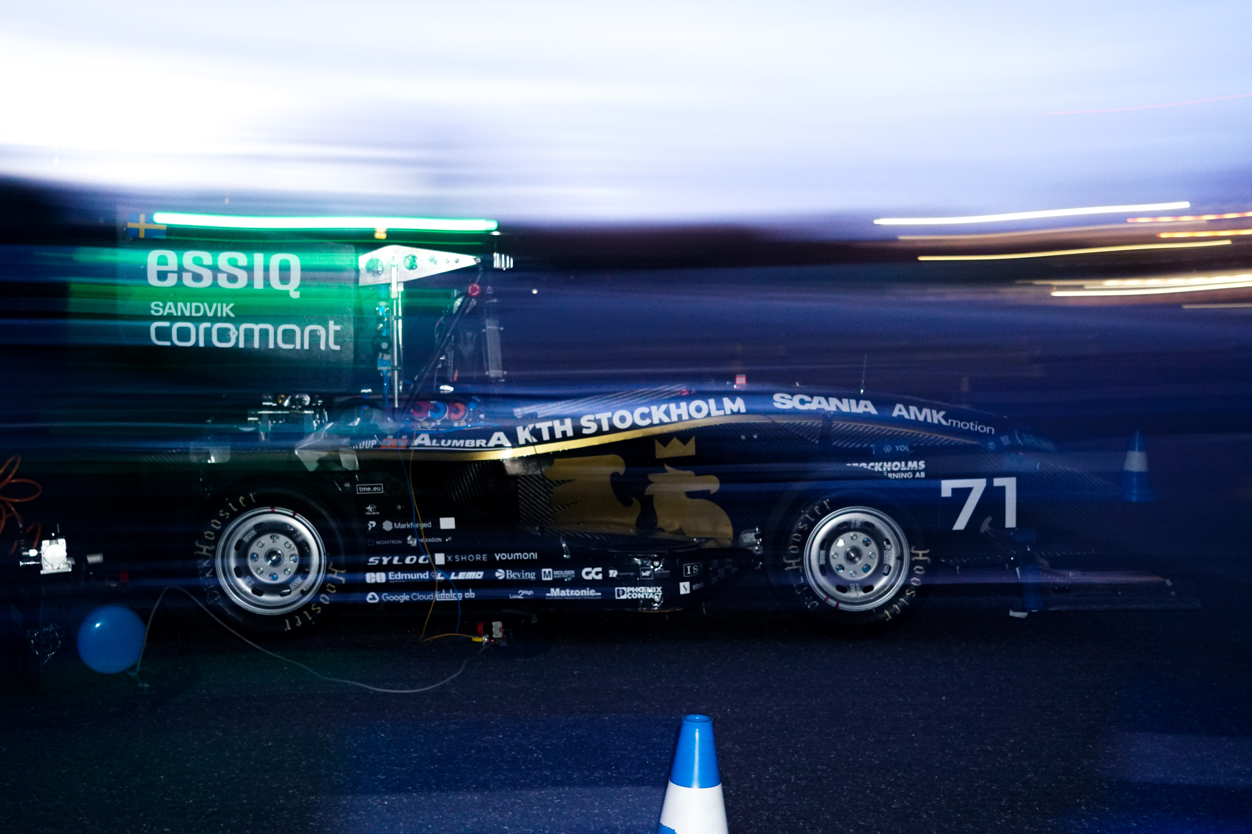
Vehicle Dynamics subgroup presentation

Slide 2
Our main purpose is to improve the vehicle performance and drivability. We work for the sake of driver satisfaction.

Slide 3
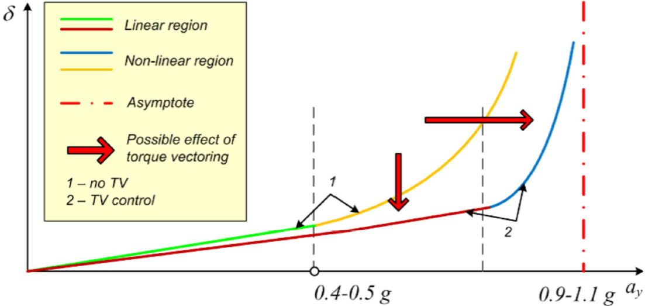
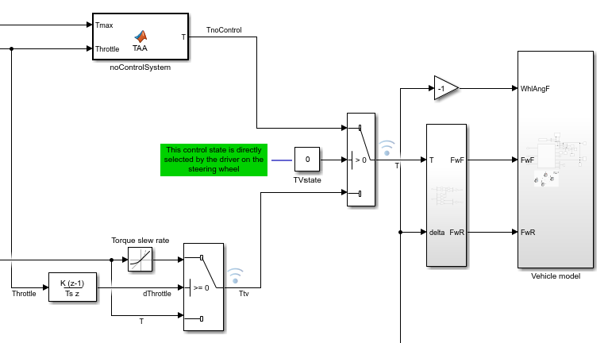
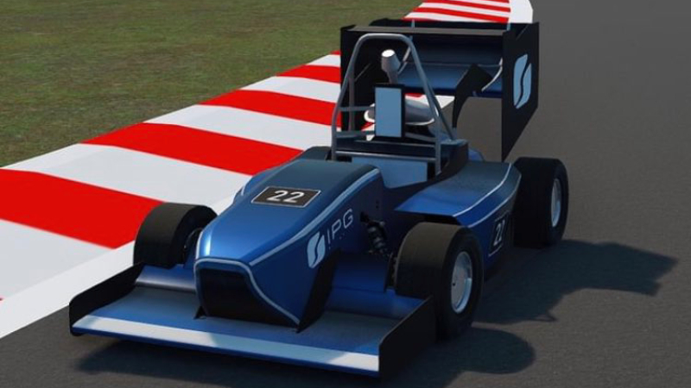
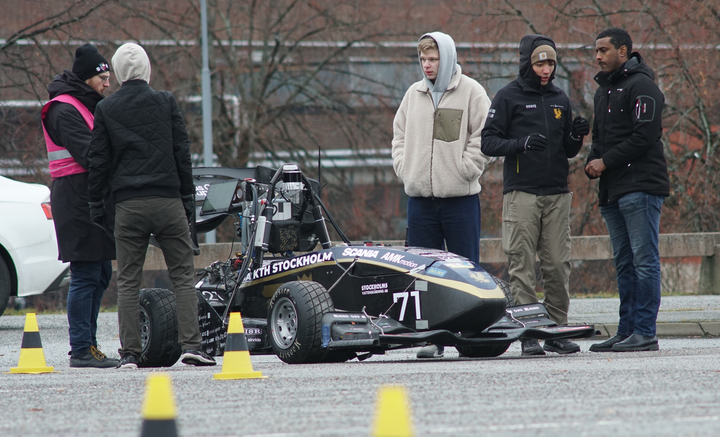

Control systems
Targets definition
Traction control;
E(electric)-ABS;
Torque vectoring;
Energy efficient control.
Simulink architecture
Simulator testing
Track test validation

Slide 4
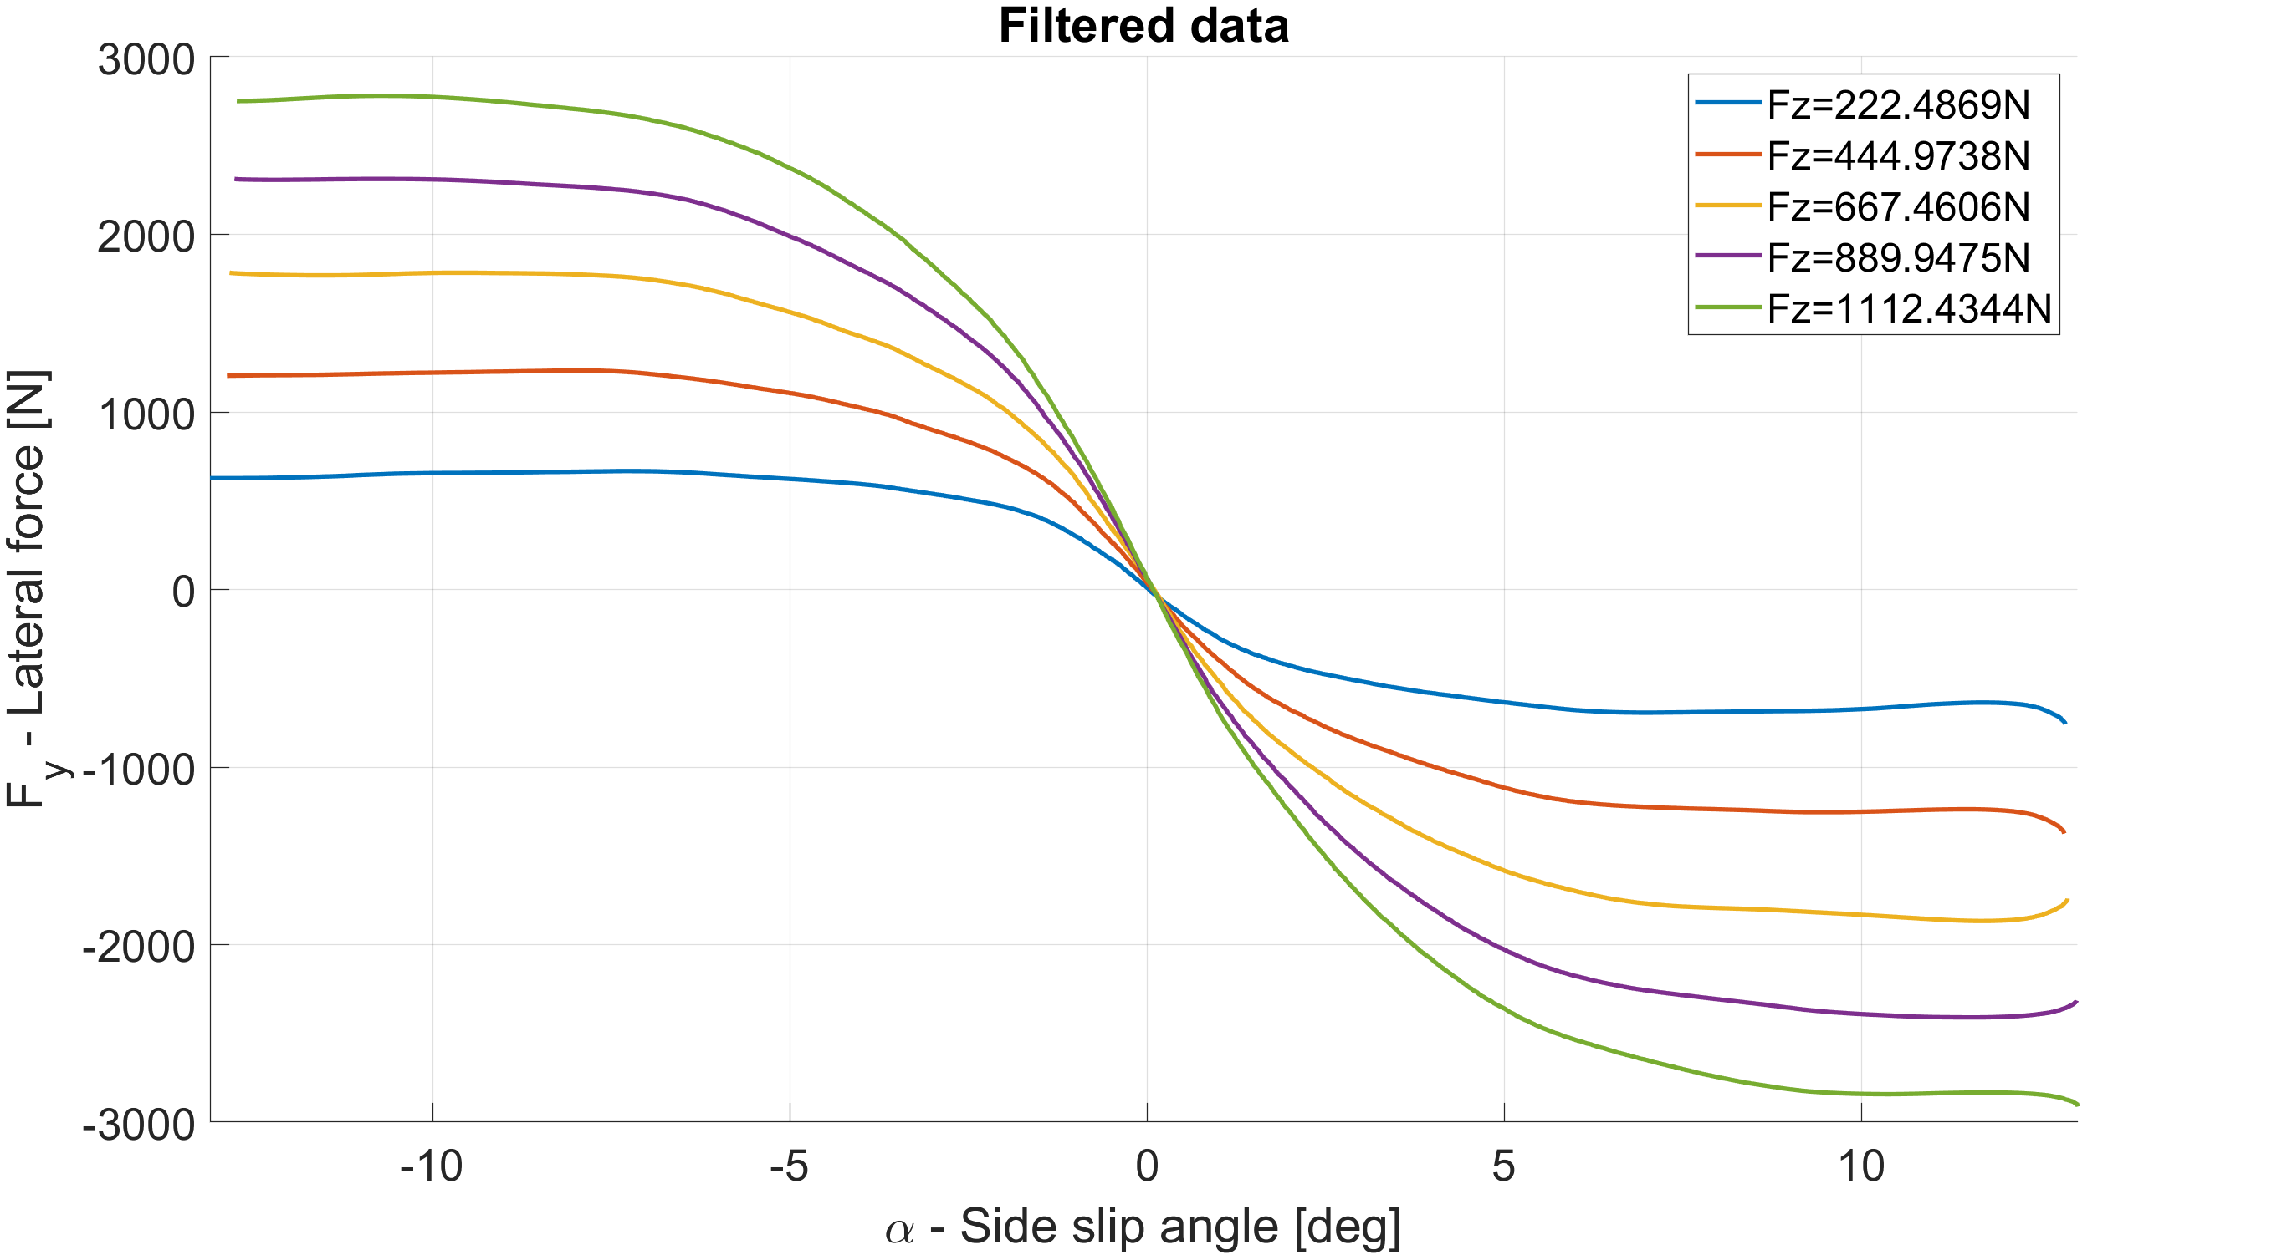
Tire modelling
Development of accurate analytical models;
Definition of optimization problems;
Thermal analysis;
Test data analysis;
Data implementation in the simulator.
TIR data analysis
Track test validation
Simulator implementation

Slide 5
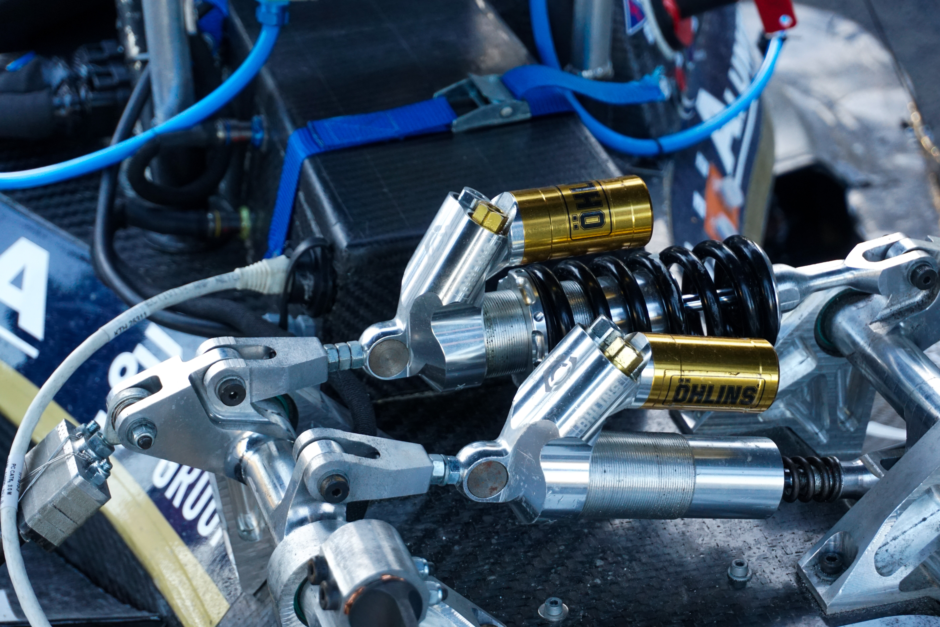
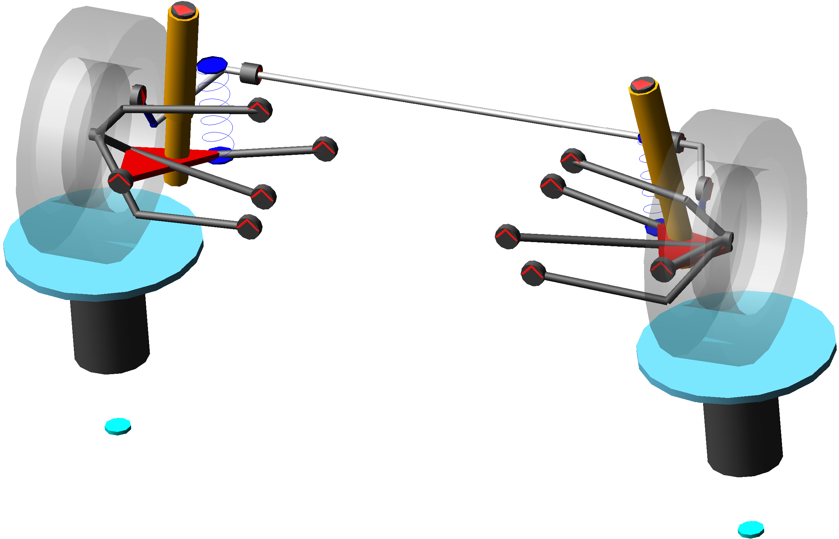
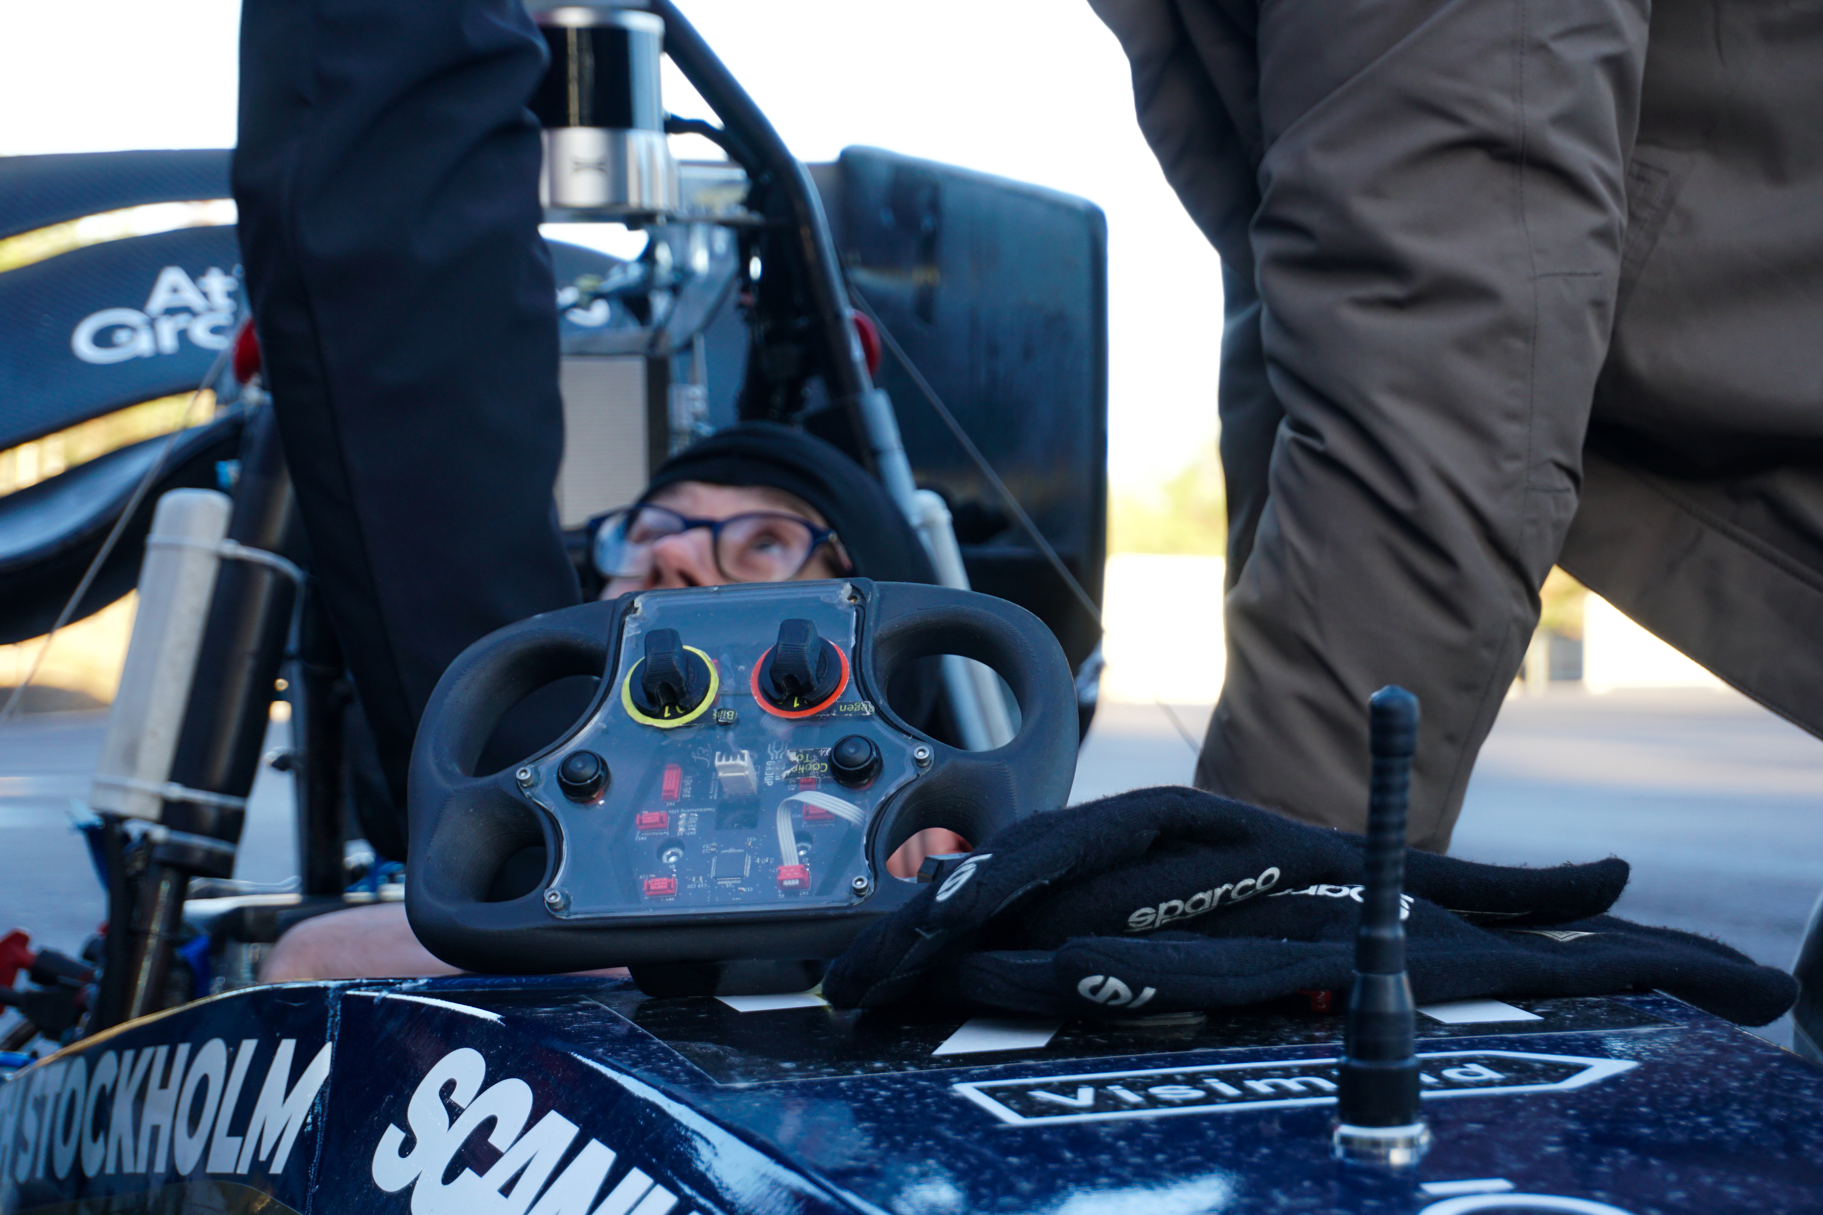
Suspension kinematics
Entire system conception
Suspension kinematics design;
Multi-body simulation;
Data implementation in the simulator.
Multi-body simulation
Driver feedback

Slide 6
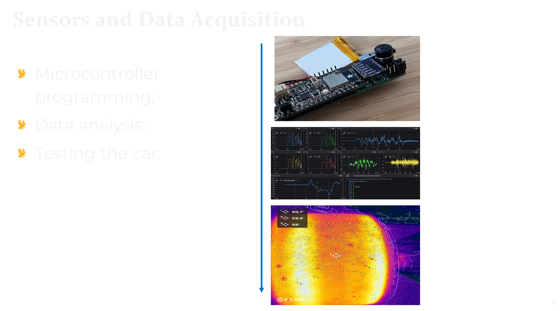

Slide 7
Expected new entries:
Control systems: 3 vacancies;
Tire modelling: 2 vacancies;
Sensors: 2 vacancies;
Suspension design: 4 vacancies.

Slide 8
Thank you for the attention!

Slide 9
Colors - Extra And how to use them
Always try to, if possible, limit to max 3 colors. On top of ”Black” and ”White”.
”Base” colors are to be used as backgrounds.
”Accent” colors are to be used for text logos and extra graphical elements.
”Pop” colors are rarely used and should only be used to make important information POP
If you need more colors, contact your local BM member
Base/Accent
Anti-Flash White
Web
#F0F3F3
CMYK
1,0,0,4
RGB
240,243,243
Accent/Base
Spanish Blue
Web
#1C75BC
CMYK
85,38,0,26
RGB
28,117,188
Accent
Honey Yellow
Web
#FCB21C
CMYK
0,29,89,1
RGB
252,178,28
Base/Accent
Oxford black
Web
#25283D
CMYK 9,8,0,76 RGB
37,40,61
Base/Accent
Oxford blue
Web
#02183C
CMYK
23,14,0,76 RGB
2,24,60
Pop
Malachite
Web: #00CC5C
CMYK: 80,0,44,20
RGB: 0,204,92
Pop
International orange engineering
Web: #B80C09
CMYK: 0,67,69,28 RGB: 184,12,9

Slide 10




Logotypes
Logotype, Large
Used as much as possible
Logotype, Medium
Our main logotypes, used in most cases and can be used on its own or combined into one (With bird on the left).
Logotype, Icon
Our Icon, should mainly be used where lines and text is hard to see/read.
or

